Slide 1

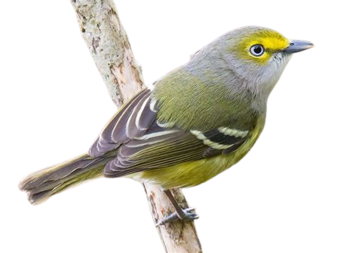


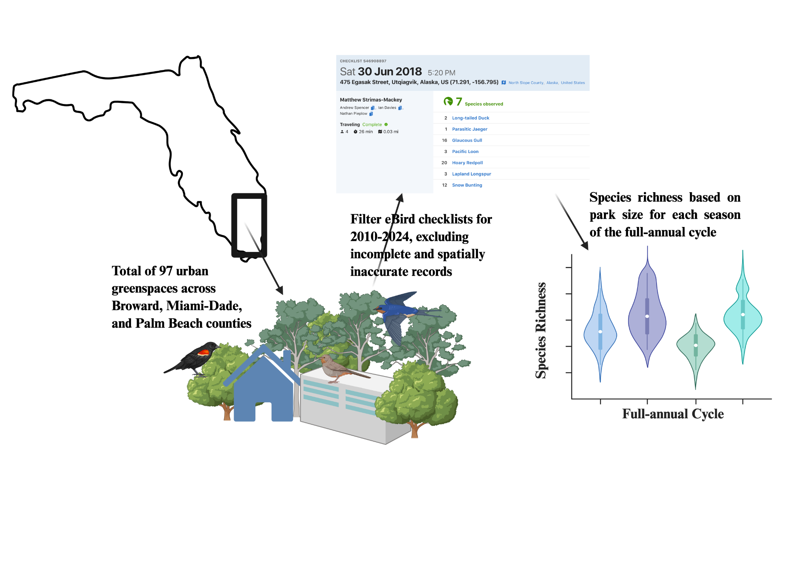
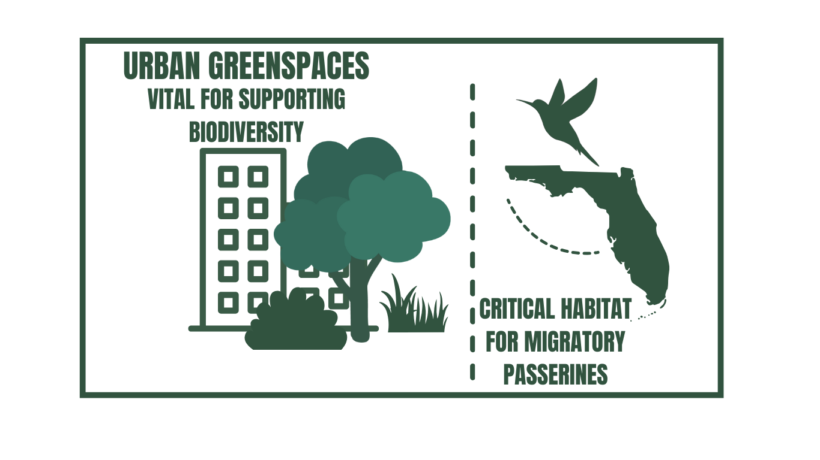
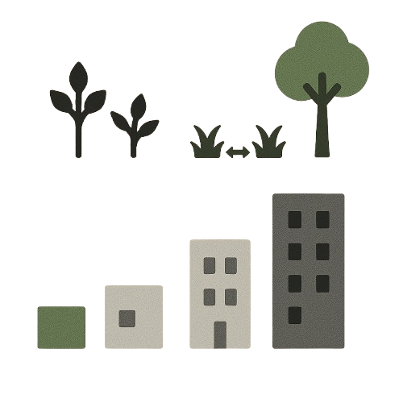
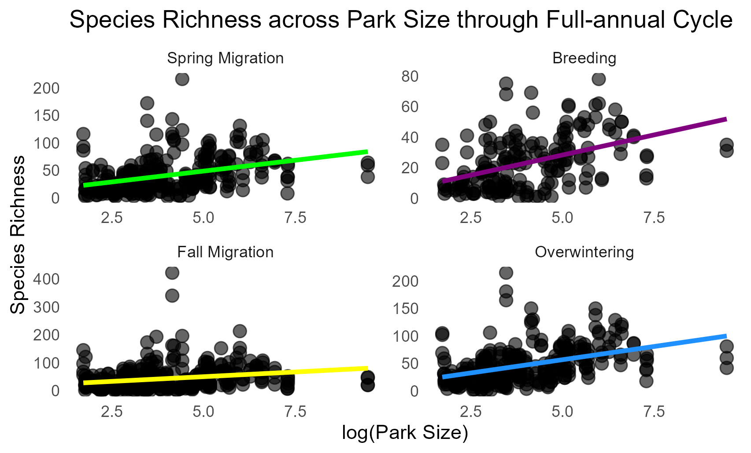
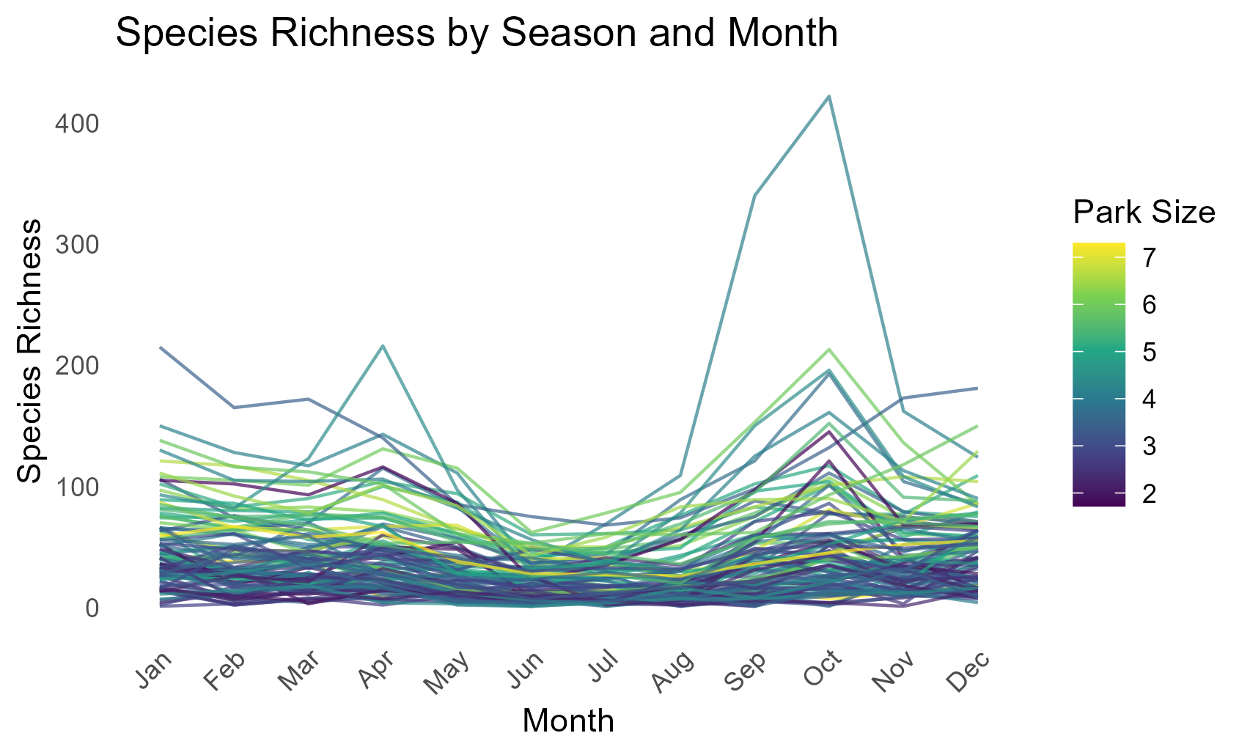
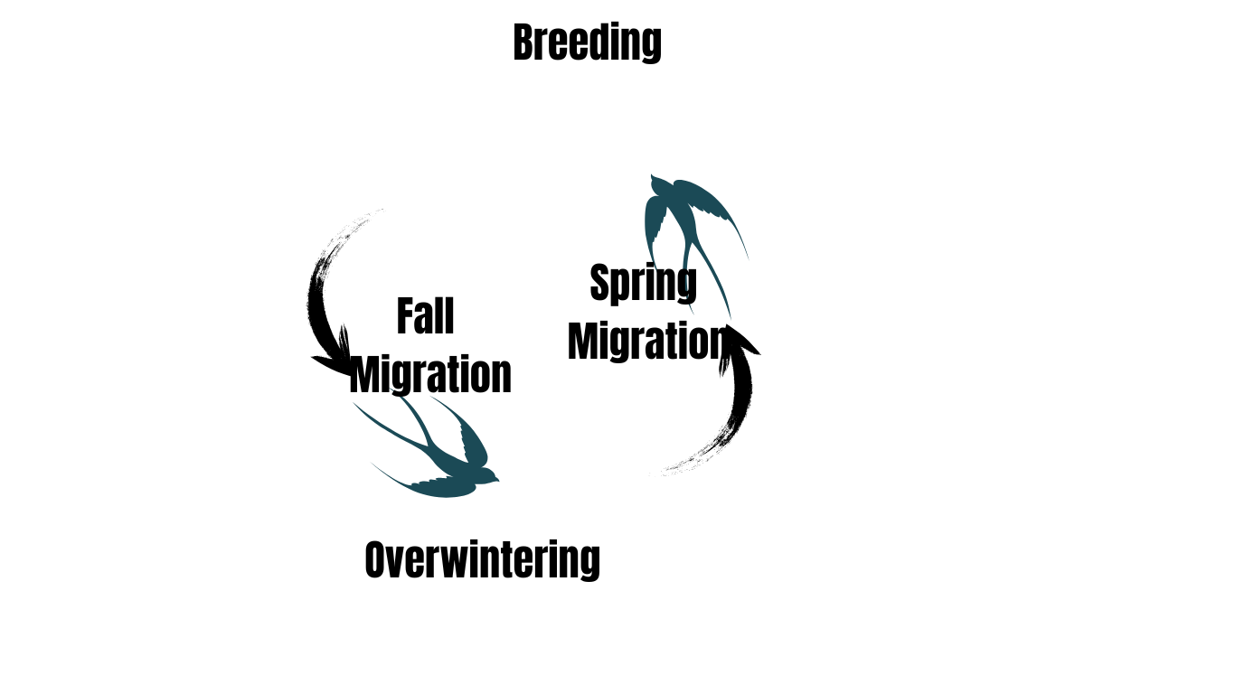
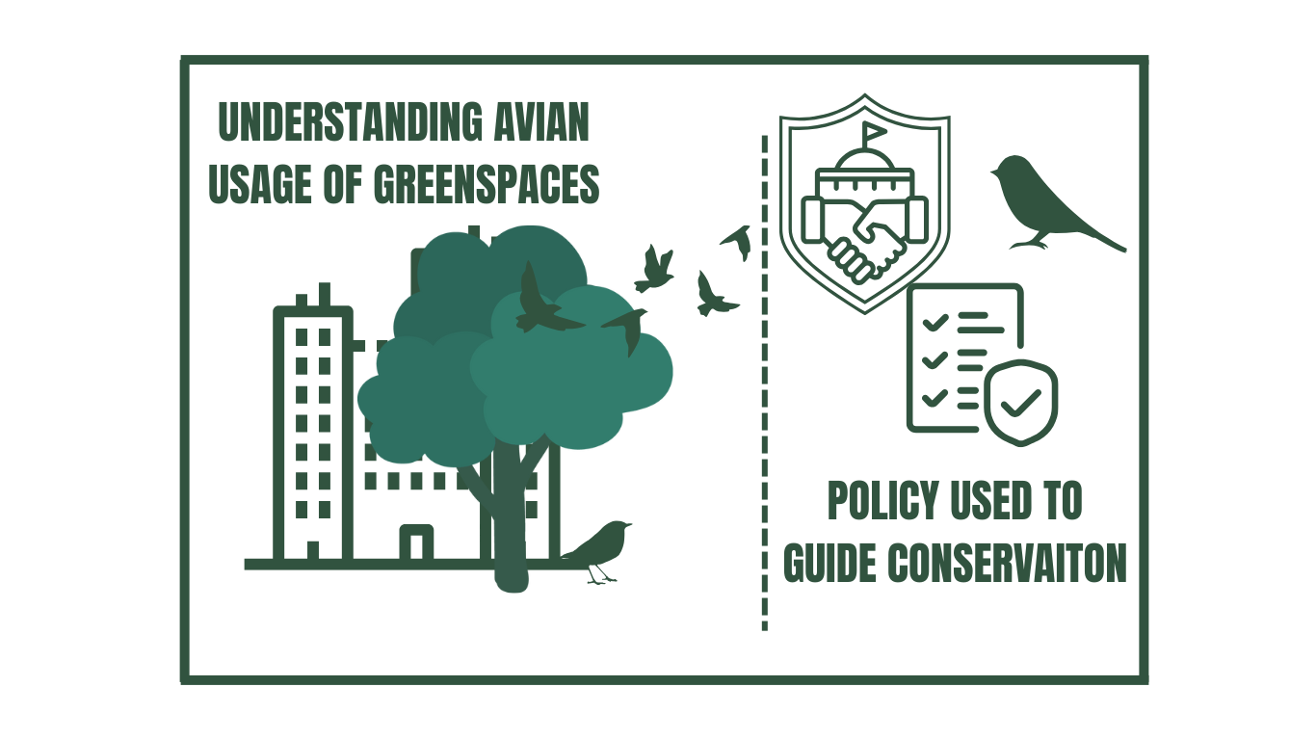
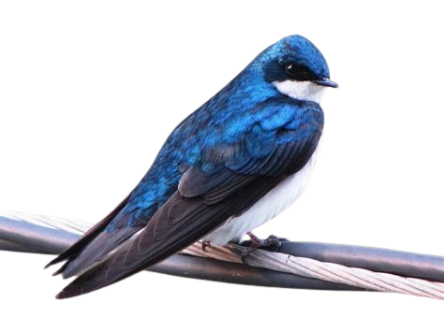
Investigating the correlation between avian biodiversity during
migration and overwintering in urban greenspaces
Levi Hoskins^{1,2} and Corey T. Callaghan^{1,2}
¹ University of Florida School of Natural Resources and Environment, University of Florida
² Fort Lauderdale Research and Education Center, Department of Wildlife Ecology and Conservation, University of Florida
Introduction
Methods
Next Steps
Urban greenspaces support biodiversity with varying degrees of effectiveness via size, connectivity, and habitat complexity.
This study examines how urban greenspaces in South Florida function as critical habitats for migratory passerines, throughout the full-annual cycle.
Habitat data
Include types of vegetation, distance to closest neighboring greenspace, and tree cover
Urbanization index
Compare different levels of urbanization across greenspaces to explain patterns observed in Figure 2.
Implications
Research Questions
Greenspaces of all sizes support species richness across seasons, but larger greenspaces tend to have the biggest contribution
Provide guidance on which species or areas need more protection to support birds in urban environments.
Supports targeted conservation strategies to enhance habitat quality and connectivity for birds in cities
Question 1 - Species-Area Relationship
Do smaller greenspaces experience higher migratory bird activity during stopover events compared to overwintering?
Question 2 - Full-Annual Cycle
Does migratory bird usage of urban patches differ between phases of the full-annual cycle?
Preliminary Results
Figure 1: Scatterplot analyzing species richness throughout the full-annual cycle.
Figure 2: Line map of species richness by month per urban greenspace. Park size is log(hectares^2).

